Slide 1
Staff Management Tool
Presented by team Dionysus Anguis

Slide 2
Content
Introduction
Hourly Basis Analysis
Daily Basis Analysis
Weekly Basis Analysis
Conclusion

Slide 3
INTRODUCTION
Our model aims to predict the most important and critical operational function in the remote IT service desk which is to make sure that enough people are on the phones to respond to calls and chats with a minimum delay. The main goal is to have the precise number of people needed at every hour of the day, every day of the week and each week of the month so as to minimize the delay.

Slide 4
Problem 1: Hourly Basis

Slide 5
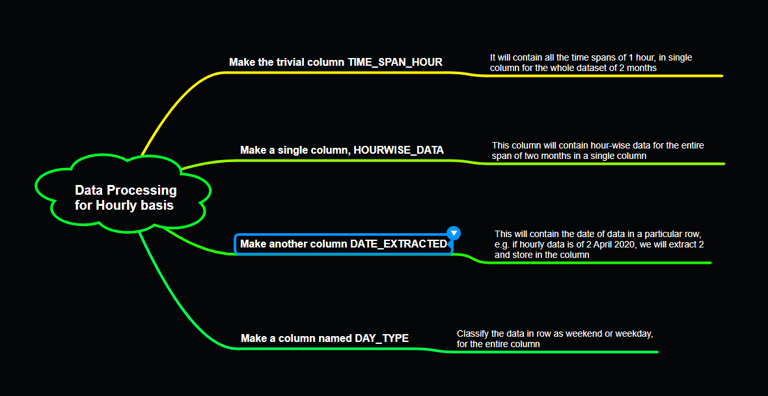
PREPARING DATASET FOR TRAINING

Slide 6
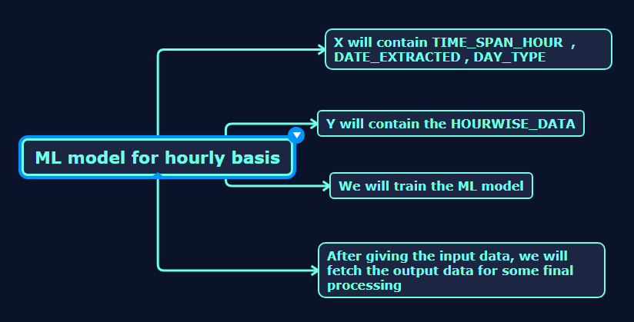
TRAINING THE MODEL

Slide 7
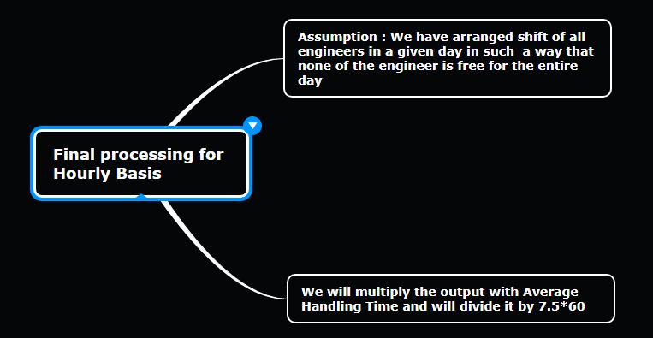
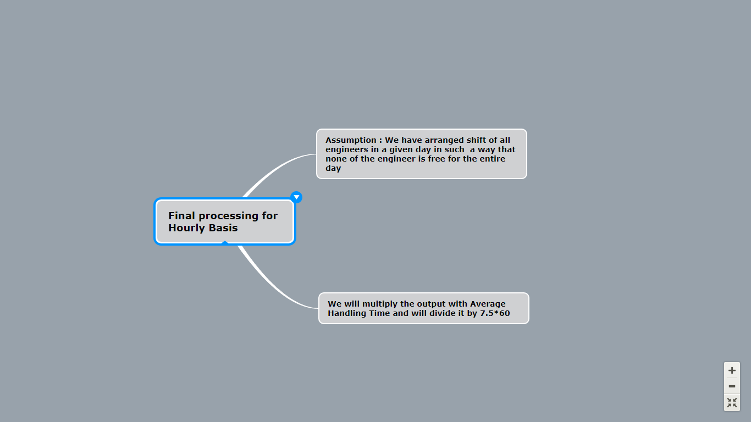
Calculating the number of RESOURCES required

Slide 8
Problem 2: Daily Basis

Slide 9
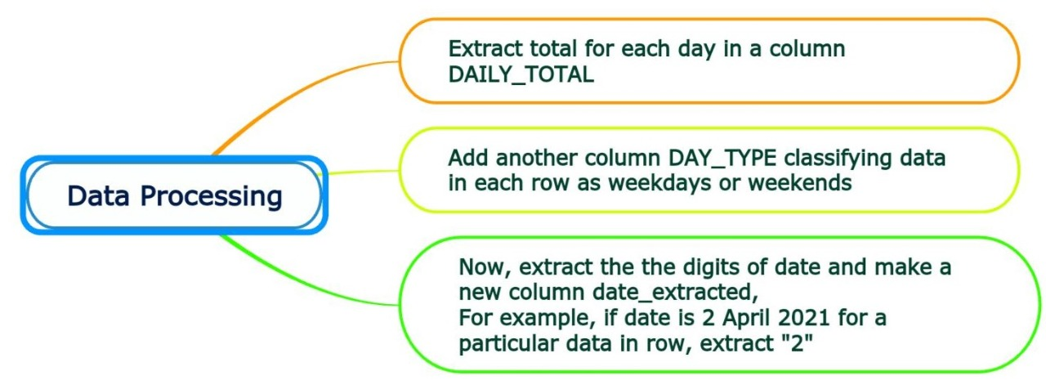
PREPARING DATASET FOR TRAINING

Slide 10
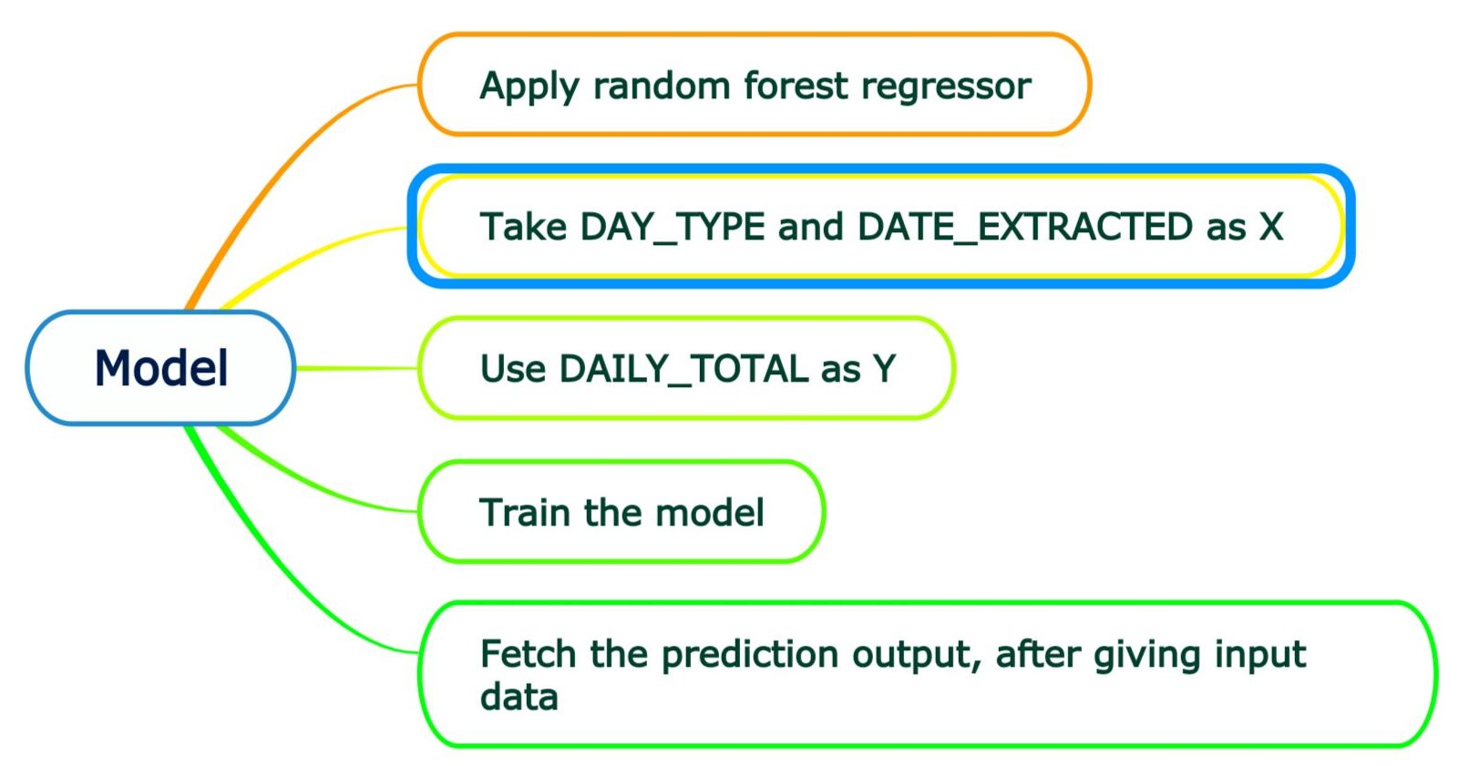
TRAINING THE MODEL

Slide 11
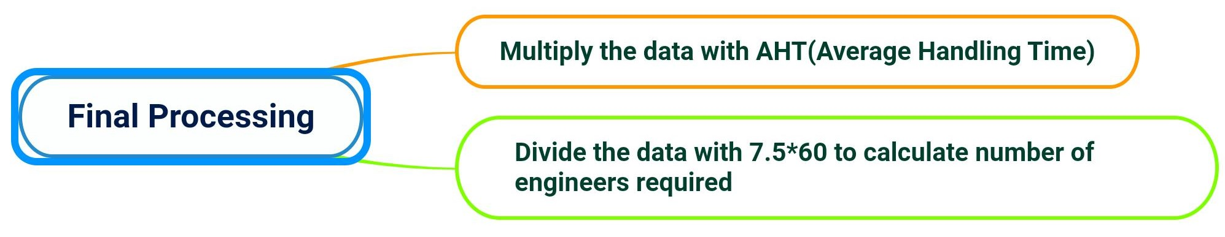
Calculating the number of RESOURCES required

Slide 12
Problem 3: Weekly Basis

Slide 13
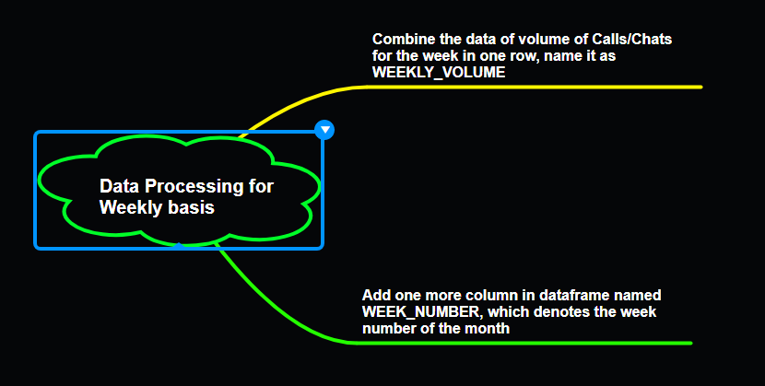
PREPARING DATASET FOR TRAINING

Slide 14
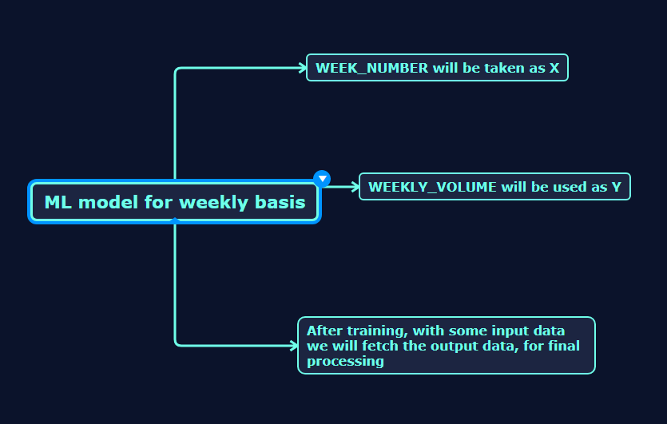
TRAINING THE MODEL

Slide 15
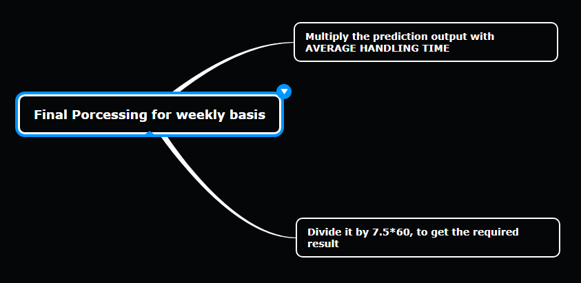
Calculating the number of RESOURCES required

Slide 16
CONCLUSION
With the data provided, we aim to ensure to have staffing round the clock.
The predictive model suggests number of engineers needed on : HOURLY BASIS, DAILY BASIS, WEEKLY BASIS
The model is retrainable after every month with new set of historical data.

